Slide 1
How to Use this PowerPoint presentation
This PowerPoint presentation is part of "Manufactured Housing: A Resource for Engaging Nonprofit Boards and Community Stakeholders." Looking for another presentation or guide? Visit our website.
If you are still learning about manufactured housing, download Manufactured Housing: Blueprint for Affordability and Community Impact.

Slide 2
Manufactured Housing for Nonprofit Developers
Developing with Manufactured Housing
What do nonprofit boards need to know?
Notes:
These organizations can provide you with research & White Papers about MH:
Next Step/Clayton
Fannie Mae
Freddie Mac
HUD’s Office of Policy and Research
Urban Institute
Manufactured Housing Opportunities for Growth (Freddie Mac) – An online toolkit put together by Freddie Mac that covers new research they've conducted, zoning being a vital part of that research.
Manufactured Housing and Zoning: Old-School Ordinances or Progressive Policies? (Next Step) – Sarah Gerecke conducted this analysis and literature review on current manufactured housing zoning and land-use policies.
The Role of Manufactured Housing in Increasing the Supply of Affordable Housing(Urban Institute) – Urban dives into how manufactured housing can address affordable housing supply (zoning is a crucial topic).

Slide 3
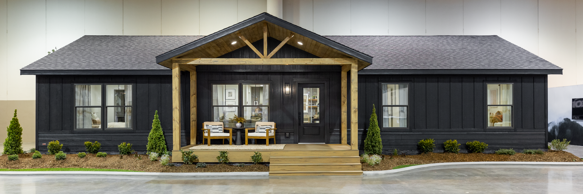
WHY Manufactured Housing?
They are modern and energy efficient, with custom home features.
They are constructed in controlled conditions.
They are constructed with the same or superior materials as site-built homes, but they are less expensive to build and purchase.
Notes:
WHY Manufactured Housing?
Manufactured homes, also known as factory-built homes, are modern and energy efficient and can be built with custom home features, such as:
tray ceilings
high-end kitchens
walk-in closets
well-appointed bathrooms
covered porches
higher roof pitch
decks
garages
These homes are constructed in controlled conditions, indoors, with state-of-the-art assembly-line techniques and licensed building trades experts. The same or superior materials are used to build manufactured homes as for site-built homes; manufactured homes are less expensive to build and purchase due to construction efficiencies.

Slide 4
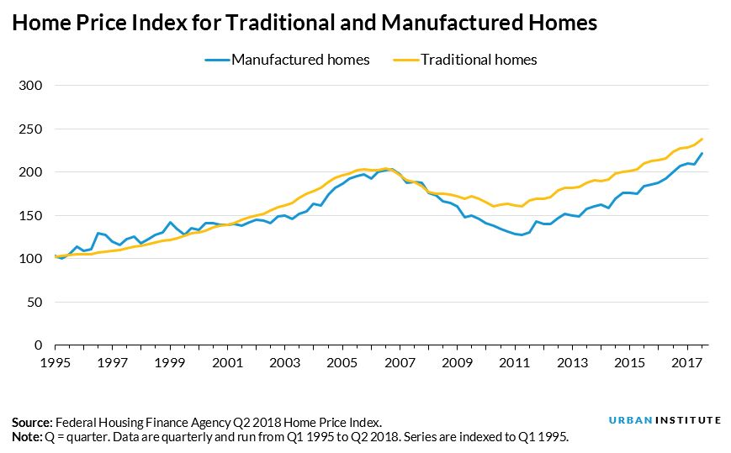
WHY Manufactured Housing?
Manufactured homes can be built/purchased with the Energy-Star rating.
They can and do appreciate in value, as long as they are well-maintained.
Manufactured homes are an affordable option for buyers in an unstable housing market.
Notes:
WHY Manufactured Housing?
Manufactured homes can be built/purchased with the Energy-Star rating.
This rating is for the whole house, not just the appliances. Manufactured homes can and do appreciate in value as long as they are well-maintained. The graph on this slide shows that site-built homes and manufactured homes appreciate at nearly the same rate as long as they are well-maintained.
Manufactured homes are an affordable option for buyers in an unstable housing market. HUD regulates the design, construction, quality, transportability, durability, fire resistance and energy efficiency of the homes and monitors compliance with the federal building code.
Advantages of owning a Factory-Built Home:
Materials are purchased in bulk quantity
Due to these bulk construction goods, manufactured homes cost less per square foot to build than site-built homes, making them a more affordable option.
Constructed in a controlled environment
Greater precision, greater security and no weather delays
Constructed by skilled tradesmen
Efficient and reduced construction cost
Reduced waste and less material theft
Manufactured homes can be built in about one-third of the time it takes to construct a site-built home.
Rapid completion once the home is on site; when the house gets to the site, it is nearly 90% complete.
Today’s models incorporate modern design: Builders can customize homes to customers' needs with wood floors, tile, granite countertops, jetted tubs, fireplaces, garages and landscaping.
Full appliance package of name brands
Inspected by HUD contractors
Next Step homes include:
Universal design (accessibility), 2x6 exterior walls, Energy Star Construction and ENERGY STAR-rated windows
All manufactured homes are wind tested to 70 MPH and 110 MPH in hurricane-prone areas.

Slide 5
Developing or Expanding a Real Estate Line of Business
Mission and vision cohesion
  How can manufactured housing fulfill a need?
  Proven success stories, visuals, and benefits to the organization.
Fitting into a real estate line of business
  Developing with manufactured housing.
  “One-stop shop.”
  Down payment assistance.
Differences in developing with manufactured housing
  Development experience.
  Education on manufactured housing.
Notes:
Developing or Expanding a Real Estate Line of Business
For nonprofit boards, if you are considering developing or expanding a real estate line of business using manufactured housing, here are some issues to consider.
Mission and vision cohesion
Organizations that have implemented manufactured housing into their lines of business see the need for affordable housing and understand how manufactured housing can play a role in providing more housing for families.
When organizations are talking with their boards about manufactured housing, they should be able to provide success stories, show visuals of completed homes, and provide proformas and how this will benefit the organization.
Fitting into a real estate line of business
Sophisticated organizations can make purchasing a home a “one-stop shop” by developing the home, being the real estate broker for the home's sale and serving as the buyer's lender. Some organizations may be able to offer down payment assistance for the buyer.
Differences in developing with manufactured housing versus site-built:
Having development experience is an advantage when starting with manufactured housing.
Work with the cities and their departments to understand the nuances of developing manufactured housing. Educating cities and their departments about manufactured housing may be essential for an organization to develop in some markets.

Slide 6
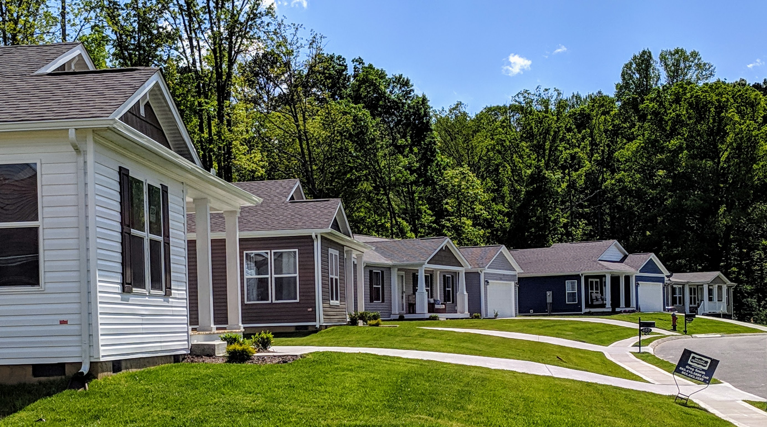
Getting Started with Manufactured Housing Programs
Engaging a retailer or manufacturer
  Licensing as a retailer
  Turnkey completion
Home placement options
  Location
  Land-lease communities
Product considerations – Choosing the right type of home
  Lot placement
  Ranch and end-loaded
Notes:
Getting Started with Manufactured Housing Programs
How do developers get started with manufactured housing programs?
Engaging a retailer or manufacturer
Organizations looking to develop with manufactured homes and work with a manufacturer directly will need to be a licensed retailer in the state where they work.
Becoming a retailer and purchasing from the factory allows developer organizations to buy homes at wholesale, control the site work, and oversee every aspect of the construction and installation of the home on-site or; in short, they are able to be the general contractor over the home completion.
Licensing as a retailer varies by state. In some states, bonds, testing and other requirements may be necessary. Organizations will need to check with the state manufactured housing association or department of housing to determine the requirements. For those organizations that can’t oversee a project or have the experience, organizations can work with retailers to receive a turnkey completion of the home. Working with a vetted retailer, the house is ordered, installed and completed using the retailer and their contractors to complete the home. The retailer is responsible for the warranty and service of that home.
Home Placement Options
Manufactured homes can be a solution for quality homes in various settings. Manufactured homes can be used in urban infill lots within a city and suburban areas where a subdivision may be developed using manufactured homes. Homes can be placed in a manufactured home community or rural area where homes are on personally owned land.
Product Considerations
Choosing the correct type of manufactured home will be determined by the location and the lot the house will be placed on. Things to consider when selecting the kind of home are lot orientation, lot size and topography, to name a few. Single-section manufactured homes can be used on more narrow lots; a multi-section home can be in two or more sections and oriented as a ranch style or an end-loaded home.

Slide 7
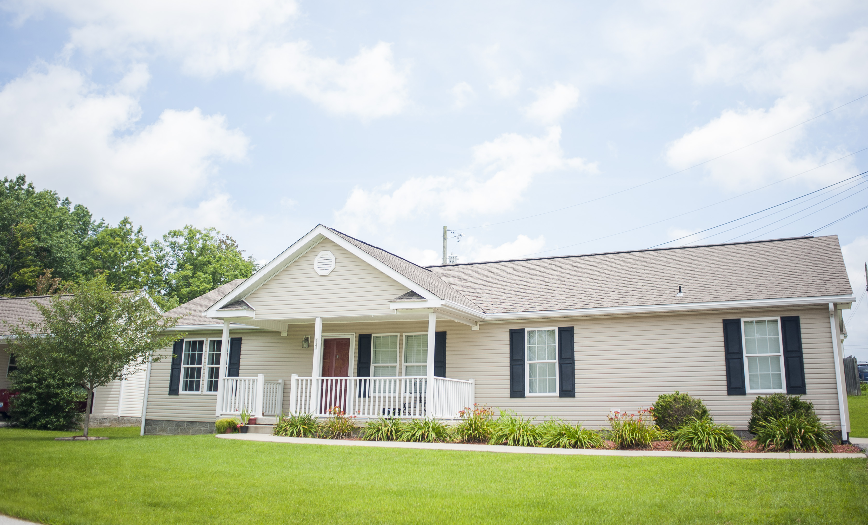
Getting Started with Manufactured Housing Programs
“New class” or CrossMod.
Considerations for scalability and growth:
  Developments
  Financing
  Capacity
Notes:
Getting Started with Manufactured Housing Programs
“New class” or “CrossMod” are industry terms for a manufactured home that meets the Fannie Mae MH Advantage and Freddie Mac CHOICEHome lending programs. These homes are designed to be comparable to site-built construction. They are built to the HUD code but have characteristics of a site-built home.
The “new class” manufactured home is a home set low to the ground with a front porch and an attached garage. These homes are typically labeled to meet the Freddie Mac CHOICEHome and Fannie Mae MH Advantage requirements. These homes can have conventional financing and use site-built comparable for the appraisal.
Here is a general list of what is included in the “new class” of homes:
Minimum roof pitch of 5/12, with 4” eaves.
The permanent foundation must meet HUD’s Permanent Foundation Guide for Manufactured Housing. It must be engineer-designed and certified for the specific dwelling and site and include a perimeter mortared masonry blocking wall set on a poured perimeter footer.
Designed with a low-profile/residential set finished floor set, the elevation should not exceed 30 inches from the bottom of the first-floor joist to the exterior grade for the front or entry (this is an installation standard, not a manufacturing requirement).
Must include at least two of the following features: Garage or carport, dormers, and covered porch.
Siding materials may be any of the following materials: vinyl, fiber cement, stucco, engineered wood siding, hardwood siding, brick or synthetic stone.
Drywall finishes throughout with upgraded finishes are optional. Bath and kitchen cabinetry with solid wood or veneer wood fronts (no paper-wrapped cabinet doors or stiles). Showers and tubs must be acrylic, composite, enamel/porcelain coated-steel, fiberglass, solid surface or tile.
Must be built to exceed current HUD energy-efficiency requirements for the property location. The dwelling must have minimum insulation values of 33 (ceiling), 11 (wall), and 22 (floor); Low-E windows and a programmable thermostat.
Considerations for scalability and growth
Organizations can scale this type of construction with urban infill, or manufactured homes can be used in a subdivision or planned development.
Financing is critical for a successful project, and you may be unable to do this without a subsidy.
Staff capacity is another point for scalability and growth. Having a dedicated staff member who is fluent in manufactured housing and knows development or partners with a developer who can do volume projects is helpful.
Rental may be a good option for some organizations to grow this line of business within their product offerings.
Becoming a licensed retailer or hiring a staff member who is a licensed retailer or has experience working on a manufactured home retail lot is also a good idea.

Slide 8

Counseling Clients about Factory-Built Homes
Understanding factory-built housing.
Discussing elements and benefits of factory-built homes
Financing factory-built housing.
Include factory-built housing in your homebuyer education workshops and counseling sessions.
Notes:
Counseling Clients about Factory-Built Homes
Factory-built housing can be an affordable option. When meeting with clients who have been priced out of the market, manufactured housing could be the solution the buyer is looking for.
Counselors can:
Inform individuals and families of the options and opportunities related to manufactured housing. Buyers may not be aware of the possibilities with manufactured housing in their markets.
Help clients understand factory-built housing by discussing the elements and benefits of manufactured housing.
Advise the consumer to shop for the loan before visiting a dealer. Although factory-built homes are financed similarly to traditional site-built homes, there may be a different process.
Advise on the two financing methods used most often (home-only and land-home) and inform the client of the other loan options available.
Include factory-built homes in conversations with clients.
Include materials in the intake packets and add a question to your intake application to help increase awareness of the available options.

Slide 9

Process for a Buyer
Seek housing counseling advising.
Understand key differences b/t site-built and new MH.
Know what you can afford.
Know where the home will be sited.
Understand the purchase and loan process.
Move in and live in the home.
Notes:
Process for a Buyer
Buying and financing a manufactured home is not that different from the traditional process.
Step One:
Talk to a housing counselor first! The buyer should know what they can afford before they visit a dealer.
Step Two:
The buyer must understand the key differences between financing a site-built home and a new MH home. A new MH home is less expensive than a comparable site-built home. The sources of where you get your loan might be different (GSE, FHA, dealer, private lender, HFA, or nonprofit.)
Step Three:
Counselors should advise on the amount the customer can afford to borrow. Address the role of down payment and closing cost assistance and know the purchase costs associated with the MH purchase, land and installation. Counselors will also discuss the monthly fees associated with manufactured housing (mortgage, chattel, lease, rent, MI, taxes).
Step Four:
A buyer must know where the home will be located. Will they own the land or rent it? The siting of the home will determine the type of financing.
Step Five:
The counselor may advise the buyer on where they can purchase the home and land. What types of loans are available: mortgage vs. chattel and lender vs. dealer. Counselors discuss the types of security (mortgage vs. chattel), the importance of prequalification and the role of DPA.
Step Six:
Buyers need to plan for maintenance and repairs, just like with a conventional home. Buyers should be aware of the ongoing costs of living in the home and costs associated with a mortgage, and non-mortgage loans. Inform buyers of the resources available to avoid foreclosure and delinquency and invest in repairs and routine maintenance for future appreciation.

Slide 10
Financing Options for Factory-Built Homes
Home-only/chattel loans are personal property financing. The client will need land (own, lease, or rent).
Mortgage (land-home) loans are used when a factory-built home and land meet certain requirements and are purchased together as real property.
Sources of financing: GSE, FHA, dealer, private lender, HFA, nonprofit)
Notes:
Financing Options for Factory-Built Homes
Chattel loans are personal property financing. They are used when a manufactured home is purchased and financed separately from the land. Chattel loans are not always necessary and are almost always more expensive. Features often include higher rates and shorter terms. The Consumer Finance Protection Bureau, or CFPB, reported that over 60% of manufactured home borrowers directly own the land where their home is located, meaning they may have been eligible for an MH mortgage. However, only 17% of these borrowers take out a chattel loan.
Mortgage loans are used when the manufactured home and land meet specific requirements and are purchased together as real property. The requirements may include a new home and installation on a permanent foundation on land owned or financed together with the home.
Who makes mortgage loans on manufactured housing?
Financial Institutions: this includes banks, mortgage companies, and credit unions.
Government Agencies: this includes the U.S. Dept. of Agriculture (USDA), Rural Development, FHA, VA, State Housing Finance Agencies, Nonprofit Lenders, and CDFIs. It is important to note that Fannie Mae and Freddie Mac have conventional mortgage products available to set manufactured housing on par with site-built financing. The latest duty-to-serve requirements from FHFA will incentivize traditional lenders to expand lending for manufactured housing.

Slide 11

Building Key Partnerships
Local Jurisdiction Planning and Officials
  Education on manufactured housing
  Planning meetings or roundtable discussions
Community Stakeholders
  Challenging NIMBY-ism
MH – Retailers and anufacturers
MH lenders
Successful MH developer organizations
Notes:
Building Key Partnerships
Next, let’s talk about building key partnerships.
Jurisdiction planning and local officials
We want our city officials to be on board with a positive change and bring new construction and homes to the area. We can set up factory tours to help bring light to today’s manufactured housing and hopefully change the stigma that many think of with manufactured housing.
Community Stakeholders
To avoid NIMBY-ism, we as an organization want to have conversations and community meetings with those in the neighborhood, explain that the vacant lots will be developed, and provide photos of the planned homes for the area. We want to be friendly neighbors and bring a positive change to the area.
Manufacturers and Retailers
Develop good working relationships with the manufacturers or retailers from which homes are being purchased. Everyone involved in the project should know the end goal to be successful. Retailers have the expertise in working in their service area and what requirements need to be followed to place a home.
Retailers and manufacturers can guide organizations in selecting homes, options, and layouts to assist in the placement of the home on-site. Manufacturers do not build the same type of home, so understanding “who builds what” is crucial as you choose a product type.
Lenders
Knowing who can finance manufactured housing is essential to a successful project. Projects will need lenders for construction financing and homebuyer financing specific to manufactured housing. Next Step has a listing of MH lenders on its website. A valuable resource is also the state housing finance agencies.
Successful Manufactured Housing Developer Organizations
Several nonprofit developers have been successful in the manufactured housing space. NeighborWorks America is an excellent resource to determine who is developing with this type of housing to make those connections. Best practices and lessons learned will be helpful as an organization begins its project.

Slide 12
Building Key Partnerships
Other resources:
  Next Step Network
  Manufactured Housing state associations
  ROC USA
  Manufactured Housing Institute
  HUD’s Office of Manufactured Housing
  I’m HOME Network
  Freddie Mac
  Fannie Mae
  MHVillage.com
  ManufacturedHomes.com
Notes:
Building Key Partnerships
This listing of organizations and collaboratives can provide support and information as we start with manufactured housing.
Next Step Network
Manufactured Housing state associations
ROC USA
Manufactured Housing Institute
HUD’s Office of Manufactured Housing
I’M Home Network
Freddie Mac
Fannie Mae
MHVillage.com
ManufacturedHomes.com

Slide 13
Current Landscape for Zoning and Land-Use Policies
HUD code for manufactured homes pre-empts local building codes.
  Modular homes meet state and/or local code (same as site-built).
Traditionally, zoning was used to segregate or eliminate “trailer parks”; outdated zoning and land-use policies can remain in effect.
  Fail to recognize the quality of today’s product.
Zoning is an inherently local issue, but states can help shield factory-built homes from exclusionary zoning (California and Oregon).
Broader interest in factory-built housing is igniting conversations and action at the federal, state and local levels.
Notes:
Opportunities with Zoning Policy
Unfortunately, zoning and land use laws often segregate or eliminate allowable placements for factory-built housing. Many of these were enacted in response to perceived concerns that it would devalue the neighborhood or lower the community's design standards, which are now ill-founded in many cases.
Implemented in 1976, the National Manufactured Housing Safety and Construction Act of 1974 (42 U.S.C. 5401-5426), also known as the HUD code, preempted state and local building codes governing the construction of manufactured housing units. While this effectively eliminated the state-level uncertainties surrounding the standards to which units would be constructed, the HUD code does not address state or local standards governing the placement of individual units onsite.
While states delegate authority for zoning to localities, they do not often affirmatively mandate zoning requirements due to the traditional deference of states to localities for determining local land use rules. More recently, however, states have begun to set conditions on local zoning, sometimes in response to exclusionary single-family zoning requirements that have roots in racial segregation and discrimination.
However, many jurisdictions fail to update their zoning statute to acknowledge changes in Federal law. In particular, several local jurisdictions use the term “mobile home” in the zoning code without recognizing that the HUD Act made these uses illegal under federal law and defines a new use, manufactured housing, to HUD code instead. Local officials may assume that the zoning code reference to mobile homes is intended to encompass, and thus exclude, manufactured homes when the local code is simply outdated. Absent updated language or an express statute that puts manufactured housing on the same footing as site-built housing, the interpretation of outdated statutory language can serve as a barrier to manufactured housing placement in many residential zones.

Slide 14
Opportunities at the Federal Level
White House Housing Supply Action Plan
Duty to Serve (Fannie Mae & Freddie Mac’s efforts to support lending and expand the market)
HUD training for counselors
Department of Energy pilot programs
Consumer Financial Protection Bureau (broad research on lending)
Notes:
Federal Policies
There are some federal policies surrounding manufactured homes that you should be aware of:
White House Housing Supply Action Plan
Duty to Serve, Fannie Mae & Freddie Mac (Support lending)
Innovative Housing Showcase on National Mall
HUD Training for Counselors
Department of Energy pilot programs (Energy Efficiency Materials Pilot Program | Department of Energy, Energy-Efficient Manufactured Homes | Department of Energy, Zero Energy Ready Homes | Department of Energy)
Consumer Financial Protection Bureau (Broad research on lending)

Slide 15
Opportunities at the State and Local Level
Tenant protections in leased communities
Recognizing resident-owned communities
Exclusionary zoning
State and local programs to finance (Oregon)
Notes:
State & Local Policies
There are also several state and local policies to know:
Tenant Protections in Leased Communities (tenant-protections-manufactured-housing-communities.pdf (freddiemac.com), MH Communities with Tenant Site Lease Protections | Fannie Mae Multifamily Guide)
Recognizing Resident-Owned Communities
State & Local Programs to Finance (Oregon) and Manufactured Home Loan Guide | 2022 Loan Options and Rates (themortgagereports.com)

Slide 16
Glossary of Key Terms
  Chattel Loan: Type of financing for manufactured homes; also known as “home-only” or “personal property” financing.
  CHOICEHome: Loan product developed by Freddie Mac for manufactured homes.
  Factory-Built Housing /Homes: General term of reference when communicating about home construction in a manufacturing environment; non-specific to manufactured, modular or other home types.
  Manufactured Homes: Homes constructed in a factory and built to the national HUD code.
Notes:
Glossary of Key Terms
We have some key words and concepts here as a glossary.
Chattel Loan: Type of financing for manufactured homes; also known as “home-only” or “personal property” financing.
CHOICEHome: Loan product developed by Freddie Mac for manufactured homes.
Factory-Built Housing/Homes: General term of reference when communicating about home construction in a manufacturing environment; non-specific to manufactured, modular, or other home types.
Manufactured Homes: Homes constructed in a factory and built to the national HUD code.

Slide 17
Glossary of Key Terms
  Manufactured Housing Community: A collection of factory-built homes that form a cohesive community structure; can be owned by a private entity or as a cooperative.
  Manufactured Housing Retailer: Locations that facilitate the tour and sale of new manufactured homes.
  Mobile Homes: A factory-built home constructed prior to 1976; used to refer to older, non-energy-efficient units that need to be replaced.
  Modular Homes: Homes constructed in a factory and built to a state or local building code.
Notes:
Glossary of Key Terms
Manufactured Housing Community: A collection of factory-built homes that form a cohesive community structure; can be owned by a private entity or as a cooperative.
Manufactured Housing Retailer: Locations facilitating the tour and sale of new manufactured homes.
Mobile Homes: A factory-built home constructed before 1976; used to refer to older, energy-efficient units that need to be replaced.
Modular Homes: Homes constructed in a factory and built to a state or local building code.

Slide 18
Glossary of Key Terms
  MHAdvantage: Loan product developed by Fannie Mae for manufactured homes.
  Mortgage Financing: A type of financing where a home structure and land are jointly financed; also known as “land-home” or “real-property” financing.
  Resident-Owned Community: A manufactured housing community structured as a cooperative.
  Site-Built Housing: A general term used for housing constructed outdoors on a designated plot of land; can be single- or multi-family.
Notes:
Glossary of Key Terms
MHAdvantage: Loan product developed by Fannie Mae for manufactured homes.
Mortgage Financing: A type of financing where a home structure and land are jointly financed; also known as “land-home” or “real-property” financing.
Resident-Owned Community: A manufactured housing community structured as a cooperative.
Site-Built Housing: A general term used for housing constructed outdoors on a designated plot of land; it can be single- or multi-family.

Slide 19
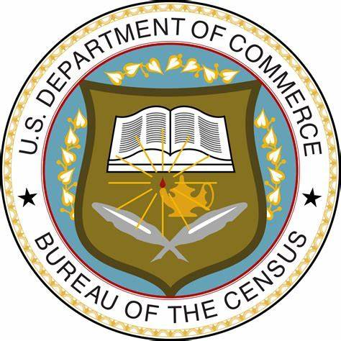

Resource Library
Data/Statistics
  U.S. Census Bureau
  Manufactured Housing Institute
Notes:
Resource Library
On this slide, we provide information on where you can find additional data and statistics about manufactured housing:
The U.S. Census Bureau and
The Manufactured Housing Institute

Slide 20

Resource Library
Research and white papers
Next Step/Clayton
Fannie Mae
Freddie Mac/UNC
HUD’s Office of Policy and Research
Urban Institute
Next Step and MH Zoning
Notes:
Resource Library
And these organizations can provide you with research & White Papers about MH:
Next Step / Clayton
Fannie Mae
Freddie Mac
HUD’s Office of Policy and Research
Urban Institute
Manufactured Housing Opportunities for Growth (Freddie Mac) - an online toolkit put together by Freddie Mac that covers new research they've conducted, zoning being a vital part of that research.
Manufactured Housing and Zoning: Old-School Ordinances or Progressive Policies? (Next Step) - Sarah Gerecke conducted this analysis and literature review on current manufactured housing zoning and land-use policies.
The Role of Manufactured Housing in Increasing the Supply of Affordable Housing(Urban Institute) - Urban dives into how manufactured housing can address affordable housing supply (zoning is a crucial topic).

